Slide 1
Signal Processing II(21ET53)
Experiential Learning Presentation
On
“Predicting Water Quality using ML Model and Hardware Integration”
Faculty Coordinator
Dr K Saraswathi
Kunal Jain 1RV21ET023 | Saumya Singh 1RV21ET047

Slide 2
CONTENTS
Introduction
Motivation
Problem Statement
Methodology
Design Specifications
Detailed Methodology with software used
Results
Inference
Conclusion
Societal concern
Reference papers in IEEE format
Appendix
Code with comments

Slide 3
Introduction
Water quality assessment is crucial for various purposes such as drinking, agriculture, and industrial processes.
Traditional monitoring methods are often manual and infrequent, leading to delayed detection of pollution events.
Real-time monitoring systems are needed to provide timely and accurate information on water quality conditions.
This presentation discusses the development of a live monitoring system for water quality assessment.
Machine learning techniques are utilized for predicting the Water Quality Index (WQI).
The project aims to improve the efficiency and effectiveness of water quality monitoring and management practices.
Overall objectives include contributing to sustainable water resource management, safeguarding public health, and protecting the environment.

Slide 4
Motivation
The motivation behind delving into water quality monitoring through machine learning models and hardware integration is multifaceted.
Primarily, it's driven by the imperative to safeguard human health and environmental integrity and access to clean water is fundamental for well-being, and real-time monitoring enhances our ability to ensure safe drinking water and prevent waterborne diseases.
Additionally, healthy aquatic ecosystems are crucial for biodiversity and ecosystem services, necessitating effective monitoring to mitigate pollution and habitat degradation
Furthermore, in a world facing escalating water challenges due to climate change and population growth, innovative technologies like machine learning offer promising solutions for efficient resource management and early warning systems during natural disasters.
Importance of leveraging advanced technologies such as sensors and machine learning for efficient water quality management.
Goal to enhance data accuracy, decision-making processes, and overall environmental stewardship through innovative monitoring approaches.

Slide 5
Problem Statement
Efficient management of water resources demands real-time monitoring of water quality, necessitating the development of an integrated system merging machine learning with hardware sensors. This project confronts the challenge of acquiring precise, timely data on key parameters such as pH, turbidity, and dissolved oxygen, and constructing predictive models capable of analyzing this information to anticipate water quality fluctuations.
Additionally, seamlessly integrating hardware sensors with machine learning algorithms presents technical hurdles that must be overcome. By creating a scalable solution, this endeavor seeks to address these obstacles, facilitating proactive decision-making and sustainable management of water ecosystems.
Through the fusion of advanced data analytics and hardware interfacing, the project endeavors to empower stakeholders with actionable insights, thereby fostering effective preservation and utilization of vital water resources.

Slide 6
Implementation
This water quality detection model employs a Random Forest Regressor Algorithm which is a machine learning algorithm that utilizes an ensemble of decision trees for regression tasks like predicting the Water Quality Index (WQI).
It constructs multiple decision trees during training and aggregates their predictions to produce a more robust and accurate overall prediction. Each tree is trained on a random subset of the data and features, reducing overfitting and improving generalization.
The data from different water samples using turbidity sensor and TDS sensors are given as an input to the model in which the algorithm performs the operation.
The regressor predicts water quality index (WQI) values. Real-time sensor readings from the given water sample are fed into the model, which then displays the predicted WQI on an LCD screen.
The model's ensemble of decision trees captures complex relationships between sensor data and WQI, enabling accurate assessments.
Users can promptly monitor and address water quality concerns based on the displayed results, aiding in effective water management and conservation efforts.

Slide 7
Random Forest Regressor Algorithm
Random Forest Regressor is a popular ensemble learning algorithm used for regression tasks.It belongs to the family of ensemble methods, where multiple models are combined to improve predictive performance.
Random Forest builds multiple decision trees during training. Each tree is trained on a random subset of the data and features.
Predictions from individual trees are aggregated to produce the final prediction. For regression tasks, this typically involves averaging the predictions.
Random Forest provides a measure of feature importance, indicating the contribution of each feature to the model's predictions.
Robust to overfitting due to the combination of multiple trees which can handle large datasets with high dimensionality.
Effective in capturing non-linear relationships and interactions between features widely used in various domains including finance, healthcare, and marketing for tasks like stock price prediction, disease diagnosis, and customer churn prediction.

Slide 8
Methodology
This project aims to predict water quality through machine learning models and hardware integration. Initially, historical data on pertinent water quality parameters is collected and preprocessed, followed by feature selection or extraction.
Machine learning algorithms, including regression or classification models, are then trained on the prepared data.
Simultaneously, sensors and hardware devices are integrated for real-time data acquisition. Systems for continuous data collection are established, enabling the models to make predictions based on incoming sensor data.
A feedback loop is instituted to refine model performance. Following deployment in the target environment, ongoing monitoring and maintenance ensure optimal system performance. This methodology offers a comprehensive approach to accurately predict water quality, facilitating effective environmental monitoring and management.
Explain the ensemble learning approach using decision trees and its advantages in prediction tasks.

Slide 9
Design Specifications
Design specifications for a project aiming to predict water quality using machine learning models and hardware integration should encompass various aspects of the system architecture, data handling, hardware selection, and performance requirements. Here's an overview of the key design specifications:
System Architecture for Live Monitoring: The model shows the interaction between machine learning models and hardware components.
Data Handling and Processing: The frequency and volume of data acquisition required for real-time monitoring is fixed according to the data storage and processing requirements, considering scalability and efficiency.
Hardware Selection: Suitable sensors like water sensor, turbidity sensor and hardware devices like breadboard ,Arduino and other connectors which are capable of measuring relevant water quality parameters with high accuracy and reliability. The factors such as sensor accuracy, precision, response time, and environmental robustness have been used.
Performance Requirements: The performance of the model with performance metrics for the system, such as prediction accuracy, response time, and data acquisition frequency are calculated.

Slide 10
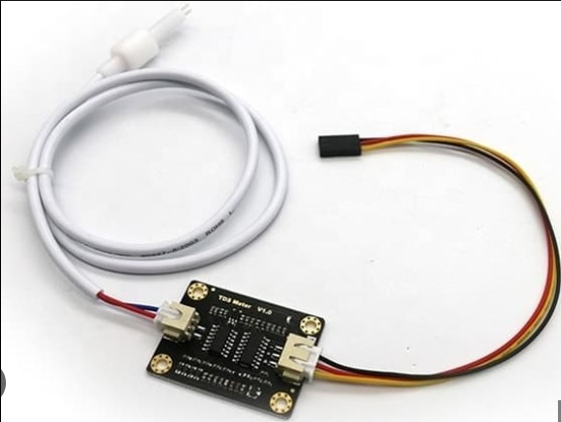
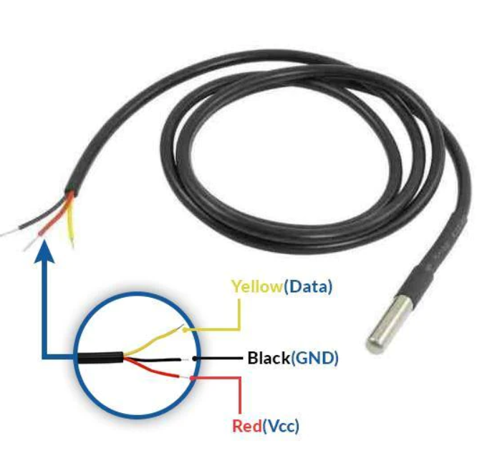
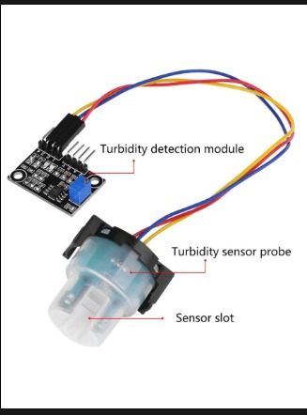
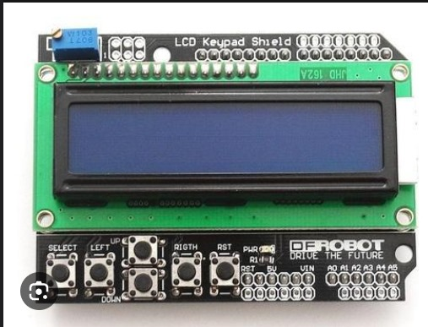
Components Required
TDS Sensor
Temperature Sensor
Turbidity Sensor
LCD(16*2)

Slide 11
Quality Parameters
SI.No. | Parameter | Fresh Water | Brackish Water | Sea Water
1 | Colour | Clean water with greenish hue<100 colour units | Clean water with greenish hue<100 colour units | Clean water with greenish hue<100 colour units
2 | Clay/Turbidity | <30 | <30 | <30
3 | Temperature | 25-32 | 25-32 | 25-32
4 | pH | 7.5-9.5 | 8.0-8.7 | 8.0-8.5
5 | Total Solid | <500 | >500 | <500
6 | Dissolved Oxygen | 5-10 | 5-10 | 5-10
7 | Total Dissolved free Carbon Dioxide | <3 | <3 | <3
8 | Hardness | 30-180 | >50 | >50
9 | Alkanity | 50-300 | >50 | >50
10 | Chlorides | 31-50 | >500 | >500

Slide 12
Code with Comments
Arduino Code with Comments
#include <Wire.h> // Library for I2C communication
#include <LiquidCrystal_I2C.h> // Library for I2C LCD
#include <OneWire.h>
#include <DallasTemperature.h>
#define TDS_PIN A0 // Analog pin for turbidity sensor input
#define TURBIDITY_PIN A1 // Analog pin for conductivity sensor input
#define ONE_WIRE_BUS 2 // Analog pin for temperature sensor input
OneWire oneWire(ONE_WIRE_BUS);
DallasTemperature sensors(&oneWire);
LiquidCrystal_I2C lcd(0x27, 16, 2); // Define LCD object with address 0x27, 16
columns, and 2 rows
void setup() {
Serial.begin(9600); // Initialize serial communication at 9600 baud
lcd.init(); // Initialize LCD
lcd.backlight(); // Turn on LCD backlight
pinMode(TDS_PIN, INPUT); // Set TDS pin as input
pinMode(TURBIDITY_PIN, INPUT); // Set turbidity pin as input
}

Slide 13
Code with Comments
void loop() {
int turbidityValue = analogRead(TURBIDITY_PIN); // Read turbidity sensor value
if (turbidityValue > 208) turbidityValue = 208; // Limit turbidity value to 208
int ntu = map(turbidityValue, 0, 208, 300, 0); // Map turbidity value to NTU scale
Serial.print("Turbidity: "); // Print turbidity label to serial monitor
Serial.println(ntu); // Print turbidity value to serial monitor
lcd.clear(); // Clear LCD screen
lcd.setCursor(0, 0); // Set LCD cursor to first row, first column
lcd.print("Turbidity: "); // Print turbidity label to LCD
lcd.print(ntu); // Print turbidity value to LCD
delay(1500); // Delay for visibility
sensors.requestTemperatures(); // Request temperature from DS18B20 sensor
float tempC = sensors.getTempCByIndex(0); // Read temperature in Celsius
Serial.print("Temperature: "); // Print temperature label to serial monitor
Serial.print(tempC); // Print temperature value to serial monitor
Serial.println(" C"); // Print unit to serial monitor
lcd.clear(); // Clear LCD screen
lcd.setCursor(0, 0); // Set LCD cursor to first row, first column
lcd.print("Temperature:"); // Print temperature label to LCD
lcd.setCursor(0, 1); // Set LCD cursor to second row, first column

Slide 14
Code with Comments
lcd.print(tempC); // Print temperature value to LCD
lcd.print((char)223); // Print degree symbol to LCD
lcd.print("C"); // Print unit to LCD
delay(1500); // Delay for visibility
int tdsValue = analogRead(TDS_PIN); // Read TDS sensor value
Serial.print("TDS: "); // Print TDS label to serial monitor
Serial.println(tdsValue); // Print TDS value to serial monitor
lcd.clear(); // Clear LCD screen
lcd.setCursor(0, 0); // Set LCD cursor to first row, first column
lcd.print("TDS: "); // Print TDS label to LCD
lcd.print(tdsValue); // Print TDS value to LCD
delay(1500); // Delay for visibility

Slide 15
Code with Comments
}
ML Model Code
import numpy as np
import pandas as pd
import seaborn as sns
import matplotlib.pyplot as plt
import os
from matplotlib import rcParams
import warnings
warnings.filterwarnings(action='ignore')
warnings.warn('This is a warning!')
data = pd.read_csv('C:\Water Quality PRediction\water_dataX.csv',encoding=
'unicode_escape')
data.head()
data.describe()
data.info()
data.shape
"""Missing Values"""
data.isnull().any()
data.isnull().sum()
data.dtypes
data['Temp'] = pd.to_numeric(data['Temp'], errors='coerce')
data['D.O. (mg/l)'] = pd.to_numeric(data['D.O. (mg/l)'], errors='coerce')
data['PH'] = pd.to_numeric(data['PH'], errors='coerce')
data['B.O.D. (mg/l)'] = pd.to_numeric(data['B.O.D. (mg/l)'], errors='coerce')
data['CONDUCTIVITY (µmhos/cm)'] = pd.to_numeric(data['CONDUCTIVITY (µmhos/cm)'],
errors='coerce')

Slide 16
Code with Comments
data['NITRATENAN N+ NITRITENANN (mg/l)'] = pd.to_numeric(data['NITRATENAN N+
NITRITENANN (mg/l)'], errors='coerce')
data['TOTAL COLIFORM (MPN/100ml)Mean'] = pd.to_numeric(data['TOTAL COLIFORM
(MPN/100ml)Mean'], errors='coerce')
data.dtypes
data['Temp'].fillna(data['Temp'].mean(), inplace=True)
data['D.O. (mg/l)']. fillna(data['D.O. (mg/l)'].mean(), inplace=True)
data['PH'].fillna(data['PH'].mean(), inplace=True)
data['CONDUCTIVITY (µmhos/cm)'].fillna (data['CONDUCTIVITY (µmhos/cm)'].mean(),
inplace=True)
data['B.O.D. (mg/l)'].fillna (data['B.O.D. (mg/l)'].mean(), inplace=True)
data['NITRATENAN N+ NITRITENANN (mg/l)'].fillna(data['NITRATENAN N+ NITRITENANN
(mg/l)'].mean(), inplace=True)
data['TOTAL COLIFORM (MPN/100ml)Mean'].fillna (data['TOTAL COLIFORM
(MPN/100ml)Mean'].mean(), inplace=True)
data.drop(["FECAL COLIFORM (MPN/100ml)"], axis=1, inplace=True)
"""Renaming the Column Names"""
data = data.rename(columns={'D.O. (mg/l)': 'do'})
data = data.rename(columns={'CONDUCTIVITY (µmhos/cm)': 'co'})
data = data.rename(columns={'B.O.D. (mg/l)': 'bod'})
data = data.rename(columns={'NITRATENAN N+ NITRITENANN (mg/l)': 'na'})
data = data.rename(columns={'TOTAL COLIFORM (MPN/100ml)Mean': 'tc'})
data = data.rename(columns={'STATION CODE': 'station'})
data = data.rename(columns={'LOCATIONS': 'location'})
data = data.rename(columns={'STATE': 'state'})
data = data.rename(columns={'PH': 'ph'})

Slide 17
Code with Comments
data
"""Claculation of pH"""
data['npH']=data.ph.apply(lambda x: (100 if(8.5>=x>=7)
else (80 if(8.6>=x>=8.5) or (6.9>=x>=6.8)
else (60 if(8.8>=x>=8.6) or (6.8>=x>=6.7)
else (40 if(9>=x>=8.8) or (6.7>=x>=6.5)
else 0)))))
"""calculation of dissolved oxygen"""
data['ndo']=data.do.apply(lambda x: (100 if(x>=6)
else (80 if(6>=x>=5.1)
else (60 if(5>=x>=4.1)
else (40 if(4>=x>=3)
else 0)))))
"""calculation of total coliform"""
data['nco']=data.tc.apply(lambda x: (100 if(5>=x>=0)
else (80 if(50>=x>=5)
else (60 if(500>=x>=50)
else (40 if(10000>=x>=500)
else 0)))))
"""calculation of B.D.O"""
data['nbdo']=data.bod.apply(lambda x: (100 if(3>=x>=0)
else (80 if(6>=x>=3)
else (60 if(80>=x>=6)
else (40 if(125>=x>=80)
else 0)))))

Slide 18
Code with Comments
"""calculation of electric conductivity"""
data['nec']=data.co.apply(lambda x: (100 if(75>=x>=0)
else (80 if (150>=x>=75)
else (60 if(225>=x>=150)
else (40 if(300>=x>=225)
else 0)))))
"""calculation of nitrate"""
data['nna']=data.na.apply(lambda x: (100 if(20>=x>=0)
else (80 if(50>=x>=20)
else (60 if (100>=x>=50)
else (40 if(200>=x>=100)
else 0)))))
"""Calculation of Water Quality Index WQI"""
data['wph']=data.npH*0.165
data['wdo']=data.ndo*0.281
data['wbdo']=data.nbdo*0.234
data['wec']=data.nec*0.009
data['wna']=data.nna*0.028
data['wco']=data.nco*0.281
data['wqi']=data.wph+data.wdo+data.wbdo+data.wec+data.wna+data.wco
data
"""Calculation of overall WQI for each year"""
average = data.groupby( 'year') ['wqi'].mean()
average.head()
from sklearn.preprocessing import LabelEncoder
le=LabelEncoder()
data.location=le.fit_transform(data. location)

Slide 19
Code with Comments
data.state=le.fit_transform(data.state)
data.head()
plt.figure(figsize=(20,20))
sns.heatmap(data.corr(), annot=True)
plt.show()
df=data.drop(['nco', 'npH', 'ndo', 'nbdo', 'nec', 'nna', 'location', 'state',
'station', 'wph', 'wdo', 'wbdo', 'wec', 'wna', 'wco', 'Temp'], axis=1)
df
df.to_csv('df')
df.corr().wqi.sort_values (ascending=False)
"""Splitting Dependent and Independent Columns"""
data.drop(['location', 'station', 'state'], axis =1, inplace=True)
data.head()
x=df.iloc[:,0:7].values
x.shape
y=df.iloc[:, -1:].values
y.shape
print(x)
print(y)
"""Splitting the Data into Train and Test"""
from sklearn.model_selection import train_test_split
x_train,x_test,y_train, y_test = train_test_split(x,y, test_size = 0.2,
random_state=10)
#Feature Scaling
#from sklearn.preprocessing import StandardScaler
#sc = StandardScaler()
#x_train = sc.fit_transform(x_train)
#x_test sc. transform(x_test)

Slide 20
Code with Comments
#Feature Scaling
#from sklearn.preprocessing import StandardScaler
#sc = StandardScaler()
#x_train = sc.fit_transform(x_train)
#x_test sc. transform(x_test)
from sklearn.ensemble import RandomForestRegressor
regressor = RandomForestRegressor (n_estimators = 10, random_state = 0)
regressor.fit(x_train, y_train)
y_pred=regressor.predict(x_test)
"""Model Evaluation"""
from sklearn import metrics
print('MAE:',metrics.mean_absolute_error(y_test,y_pred))
print('MSE:',metrics.mean_squared_error(y_test,y_pred))
print('RMSE:',np.sqrt(metrics.mean_squared_error(y_test,y_pred)))
metrics.r2_score(y_test, y_pred)
regressor.predict([[5.7,7.2,189.0, 2.000000, 0.200000, 8391.0, 2014 ] ])
regressor.predict([[6.7,7.5,203.0,6.940049, 0.1, 27.0, 2014]])
import pickle
pickle.dump(regressor,open('model.pkl','wb'))
model=pickle.load(open('model.pkl','rb’))

Slide 21
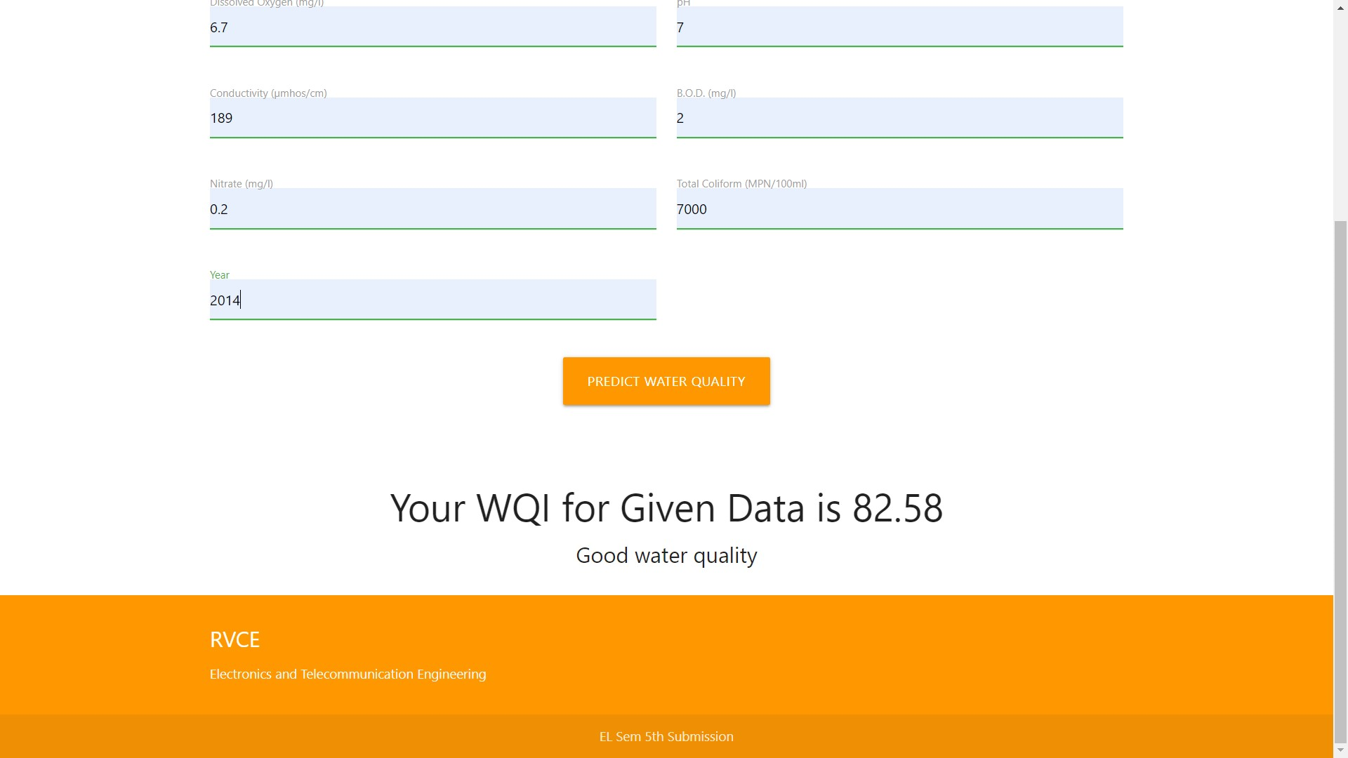
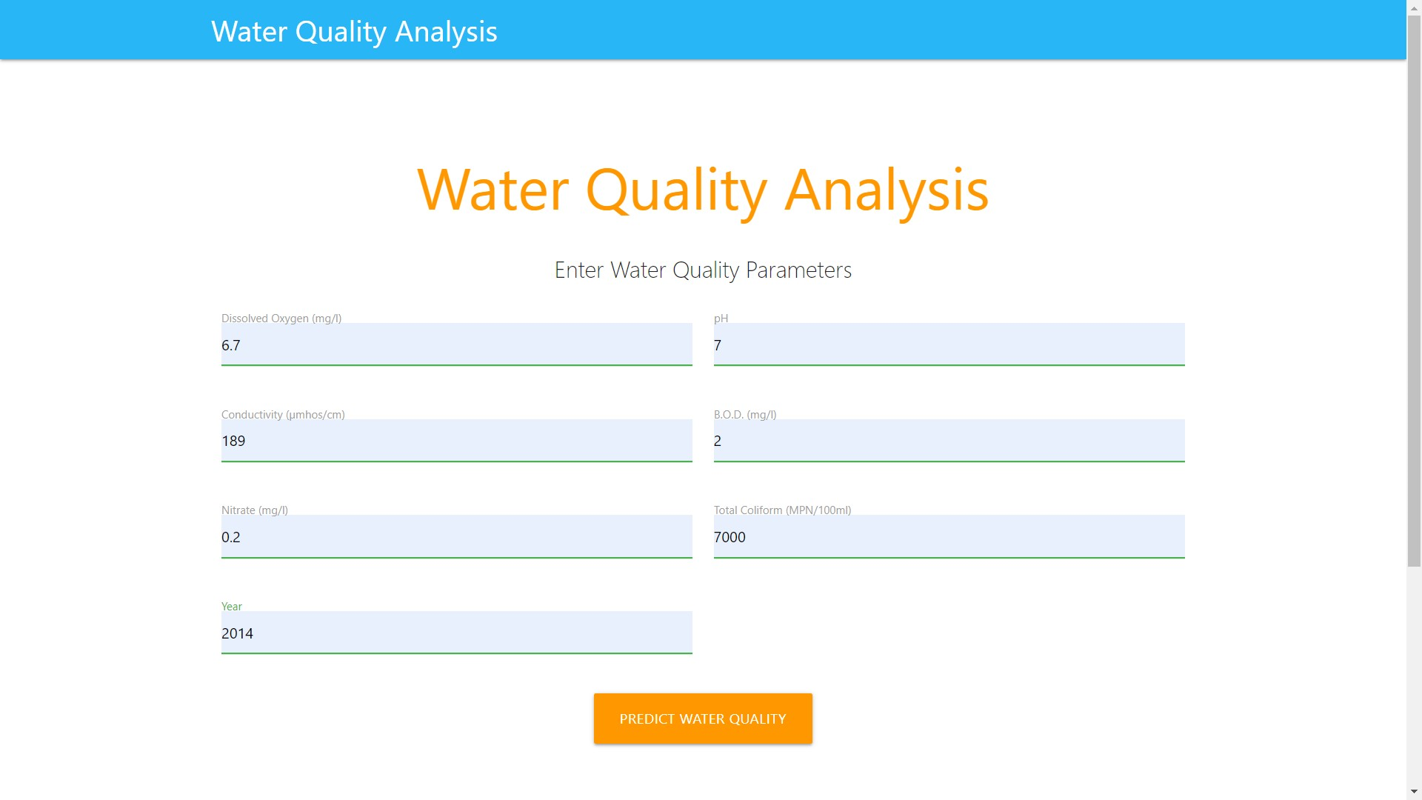
Results
Water Quality obtained for the given data
Water Quality Parameters

Slide 22
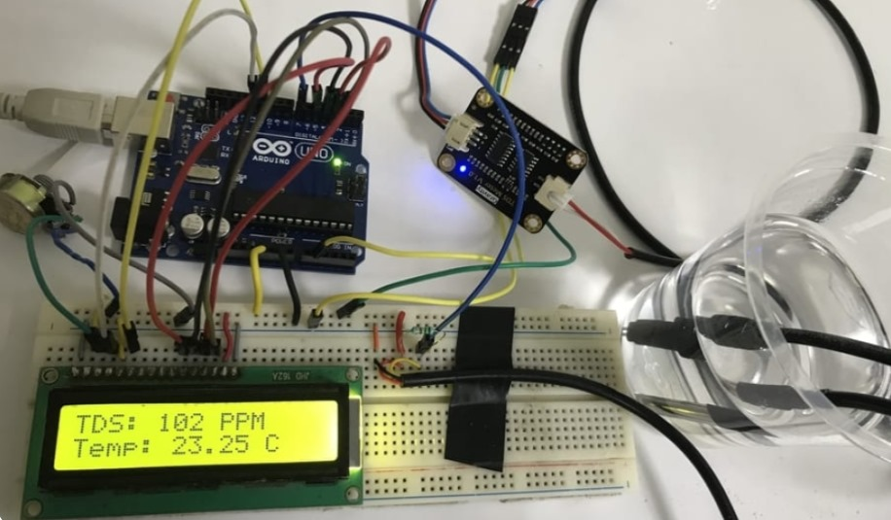
Results
Water Quality Detection Model with Integrated Hardware Components

Slide 23
Inference
Predicting water quality through machine learning models and hardware integration holds immense potential for addressing critical societal concerns.
By leveraging data-driven approaches and real-time monitoring technologies, this project offers proactive solutions to safeguard public health, preserve ecosystems, and promote sustainable water management practices.
Accurate prediction of water quality parameters enables early detection of contamination events, facilitating timely interventions to protect communities from waterborne diseases and mitigate environmental risks.
Moreover, the integration of hardware devices enhances the efficiency and reliability of data collection, supporting informed decision-making and resource allocation. Through collaboration between interdisciplinary teams and stakeholders, this project contributes to advancing technological innovation in environmental monitoring and fosters greater awareness and accountability for water quality preservation.
Ultimately, the successful implementation of this project has the potential to improve public health outcomes, enhance ecosystem resilience, and ensure equitable access to clean water resources for present and future generations.

Slide 24
Conclusion
In conclusion, the integration of machine learning models with hardware for predicting water quality represents a promising approach to addressing pressing societal concerns.
Through accurate monitoring and prediction of water quality parameters, this project offers proactive strategies for protecting public health, preserving ecosystems, and promoting sustainable water management practices.
The real-time data acquisition and advanced analytics, stakeholders can make informed decisions to mitigate risks associated with waterborne contaminants and pollution events.
Furthermore, the scalability and flexibility of the proposed system allow for adaptation to diverse environmental conditions and monitoring scenarios.
Overall, the successful implementation of this project has the potential to significantly impact global efforts towards ensuring access to clean and safe water resources, fostering environmental sustainability, and enhancing the well-being of communities worldwide.
Continued research, collaboration, and innovation in this area are essential for realizing the full potential of machine learning-based water quality prediction systems.

Slide 25
Societal concern
One significant societal concern addressed by this project is the protection of public health. Access to clean and safe drinking water is a fundamental human right, yet many communities around the world face challenges due to waterborne contaminants and pollutants.
By accurately monitoring parameters such as pH levels, turbidity, and the presence of contaminants, this project enables early detection of water quality issues, allowing authorities to implement timely interventions to safeguard public health. Furthermore, this project contributes to environmental sustainability by supporting the conservation and preservation of natural water ecosystems.
Monitoring water quality in rivers, lakes, and oceans helps mitigate the impact of pollution and habitat degradation on biodiversity and ecosystem health. By detecting changes in water quality patterns, stakeholders can implement measures to mitigate environmental threats and promote the sustainable management of water resources.

Slide 26
References
[1]. Uddin, M. G., Nash, S., Rahman, A., & Olbert, A. I. (2023). A novel approach for estimating and predicting uncertainty in water quality index model using machine learning approaches. Water Research, 229, 119422. https://doi.org/10.1016/j.watres.2022.119422
[2]. Adeleke, I. A., Nwulu, N., & Ogbolumani, O. A. (2023). A hybrid machine learning and embedded IoT-based water quality monitoring system. Internet of Things, 22, 100774. https://doi.org/10.1016/j.iot.2023.100774
[3]. Bhardwaj, A., Dagar, V., Khan, M. O., Aggarwal, A., Alvarado, R., Kumar, M., Irfan, M., & Proshad, R. (2022). Smart IoT and machine learning-based framework for water quality assessment and device component monitoring. Environmental Science and Pollution Research, 29(30), 46018–46036. https://doi.org/10.1007/s11356-022-19014-3
[4]. Sakaa, B., Elbeltagi, A., Boudibi, S., Chaffaï, H., Islam, A. R. M. T., Kulimushi, L. C., Choudhari, P., Hani, A., Brouziyne, Y., & Wong, Y. J. (2022b). Water quality index modeling using random forest and improved SMO algorithm for support vector machine in Saf-Saf river basin. Environmental Science and Pollution Research, 29(32), 48491–48508. https://doi.org/10.1007/s11356-022-18644-x
[5]. Araneta, A. a. S. (2022). Design of an Arduino-Based water quality monitoring system. International Journal of Computer Science and Mobile Computing, 11(3), 152–165. https://doi.org/10.47760/ijcsmc.2022.v11i03.017

